Slide 1

DRLE: Decentralised Reinforcement Learning at the Edge for Traffic Light Control in the IoV
Presented by Pengyuan Zhou, Xianfu Chen, Zhi Liu, Tristan Braud, Pan Hui, Jussi Kangasharju
Team Number : 8

Slide 2






The Urban Traffic Dilemma: A Growing Challenge
Urban areas are increasingly gridlocked despite abundant real-time data from connected vehicles. Traditional traffic light systems are rigid and cannot adapt to dynamic traffic patterns or scale efficiently across vast city networks.
Visible Traffic Issues
Surface-Level Problems
System Inefficiencies
Underlying Causes
Data & Adaptability Issues

Slide 3
Why it's an Edge Problem
Latency matters: Traffic lights must respond to real-time vehicle flow.
Scalability issues: Centralised systems can't handle vast traffic data quickly.
Edge computing provides localised processing near traffic signals, enabling low-latency decision-making.
IoV data collected at the edge improves responsiveness and accuracy.
So, it demands edge infrastructure to support real-time, decentralised control..

Slide 4
Limitations of Existing Traffic Control Methods
Previous approaches fall short in addressing the complexities of modern urban traffic.
0%
10%
25%
Lacks learning ability
Requires precise modeling
Not adaptive to dynamic environments
5%
15%
Aren't practical for real-world deployment
Lack theoretical guarantees of global optimality

Slide 5
DRLE's Innovative Three-Level Hierarchical Approach
DRLE employs a sophisticated three-level hierarchy to manage traffic light control, leveraging multi-agent Deep Q-Networks (DQN) at edge servers.
Intersection Level
1
Simple threshold control for immediate responses.
Intra-ES Level
2
Multi-agent RL for main optimisation logic within edge servers.
Inter-ES Level
3
Parameter tuning and coordination across multiple edge nodes (ES1).
This layered architecture ensures both localised efficiency and global coordination, supported by mathematical proofs of optimality and convergence.

Slide 6
Key Contribution: The DRLE Framework
Decentralised Multi-Agent Deep Q-Network (DQN) at the edge:
Breaks down centralised control into per-intersection agents
Each agent learns a policy to control traffic lights using local IoV data
The architecture allows parallel, cooperative learning across intersections
Built using open-source tools: Flow, SUMO, Ray, RLlib

Slide 7
Navigating the Challenges of Edge-Based RL
Challenges addressed Scalability: Solved by decomposing the problem and distributing computation.
Latency: Mitigated using edge servers near intersections.
Theoretical optimality: Proved with mathematical reasoning.
Real-world deployment readiness: Ensured by using practical network simulation (NS-3) and edge-friendly design.
Communication constraints: Efficient V2X communication modeled and shown to have low delay.

Slide 8
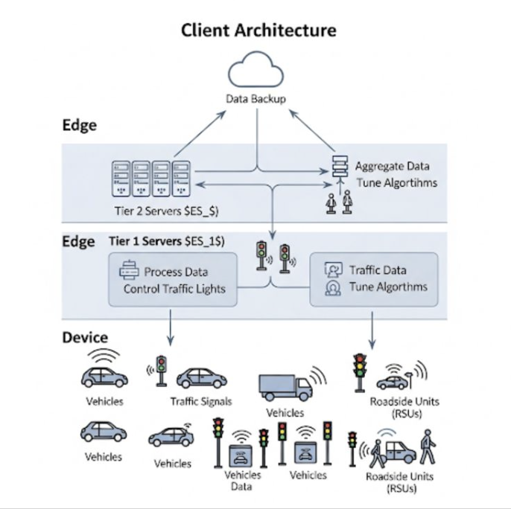
Architecture Diagram

Slide 9
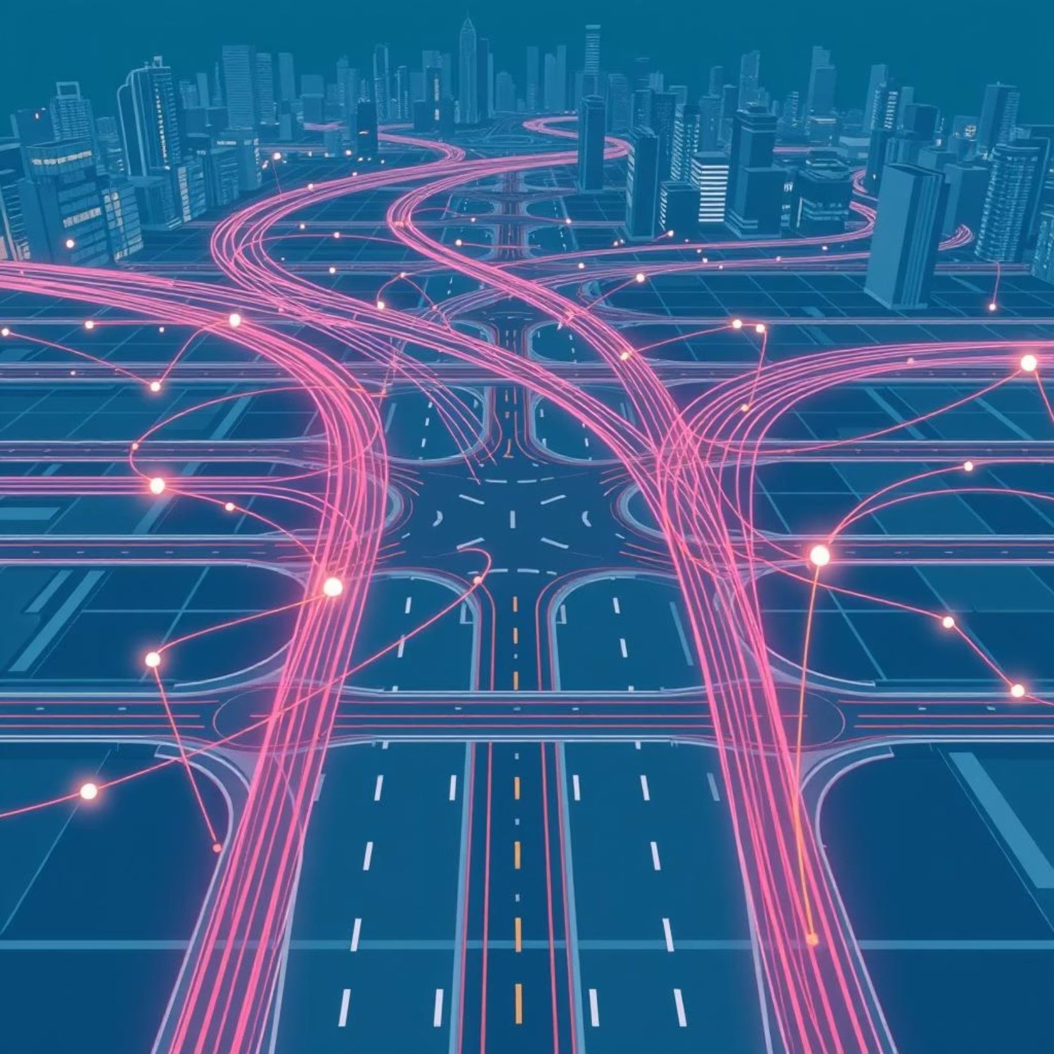
Implementation Strategy & Evaluation
Implementation strategy (Simulation setup & tools) Simulator: SUMO (for traffic simulation)
RL library: RLlib (via Ray)
Integration platform: Flow
Algorithm tested: DQN, Distributed DQN (dDQN), PPO, ES, ARS
Hardware: Trained on a GPU-powered workstation
Evaluation scale: Grid networks with 5×5, 10×10, 15×15 intersections

Slide 10
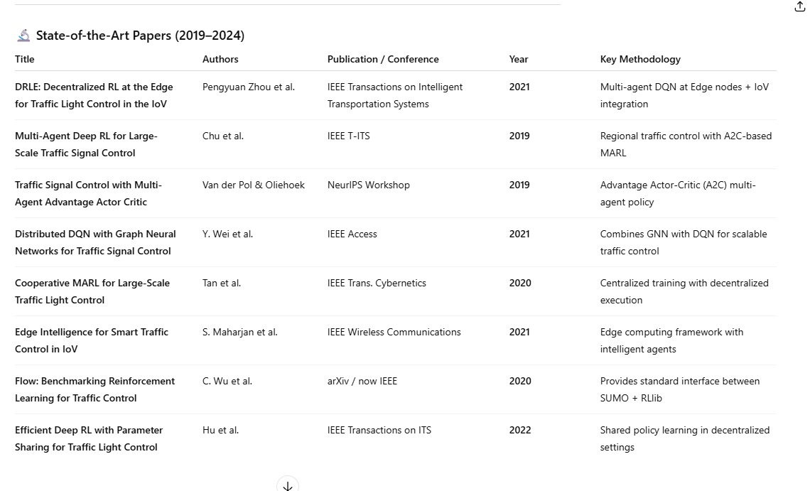

Slide 11
Team Task Allocation for DRLE Development
A structured approach ensured comprehensive coverage of all aspects of the DRLE project.
1
System Design & Architecture
2
Algorithm & Theoretical Proof
Focus on edge-layer components, IoV data flow, and the DRLE hierarchy (Intersection, ES1, ES2).
Detailed analysis of RL models, Q-function decomposition, and convergence theorems.
3
Simulation & Evaluation
4
Result Analysis & Communication
Setup of SUMO, Flow, and RLlib environments; analysis of training performance metrics.
Evaluation of traffic improvements, scalability, delays, and comparison with baseline algorithms.

Slide 12

DRLE: The Future of Smart City Traffic
DRLE stands as a scalable, real-time, and intelligent edge-based solution for smart city traffic management, showcasing clear advantages over traditional centralised models through robust theoretical guarantees and comprehensive experimental validation.
This framework marks a significant leap towards truly adaptive and efficient urban mobility systems.

